Slide 1
Large-Scale and Multi-Structured Databases AnimeAdvisor
Aniello Giuseppe, De Filomeno Elisa, Secondulfo Valerio

Slide 2
Introduction
Anime Advisor is an application that allows users to search for Animes (japanase animation products), vote review them and put a Like.
The application presents a social side in which users can follow each other and see their preferences and activities like the animes their’re following or have reviewed.

Slide 3
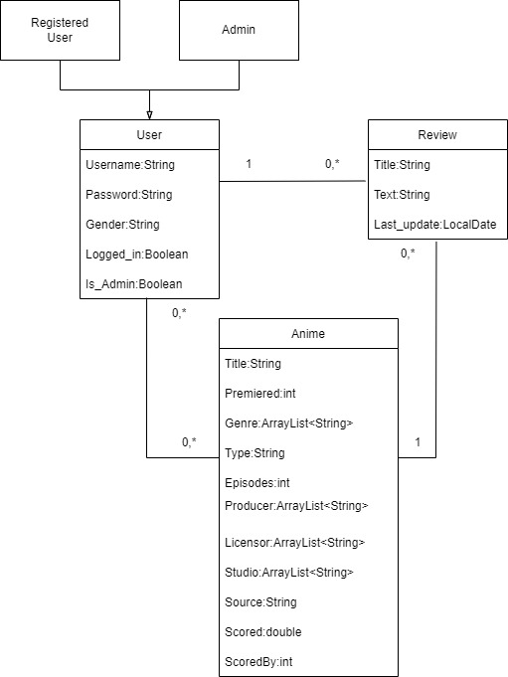
UML CLASS DIAGRAM

Slide 4
DATASET USED
Anime:
Dataset 1:
Link: https://www.kaggle.com/vishalmane10/anime-dataset-2022
Source: https://www.anime-planet.com/
Dimension: 13,6 MB
Dataset 2:
Link: https://www.kaggle.com/oksanakalytenko/anime-recommendations/data
Source: https://myanimelist.net/
Dimension: 1,95MB

Slide 5
DATASET USED
User:
Link: https://www.kaggle.com/marlesson/myanimelist-dataset-animes-profiles-reviews?select=profiles.csv
Source: https://myanimelist.net/
Dimension: 8.66 MB
Review:
Link: https://www.kaggle.com/marlesson/myanimelist-dataset-animes-profiles-reviews?select=reviews.csv
Source: https://myanimelist.net/
Dimension: 654MB

Slide 6
Non functional requirements
Data Consistency: All the users must see the last version of the data and the update operations must be performed in the same order in which they are issued.
Performance: A low response time is necessary in order to give to the users the informations requested in the lowest time possible.
Reliability : The application must never crash, all errors and critical points must be managed with exceptions.
Usability: The application’s interface has to be user-friendly and intuitive for the user.

Slide 7
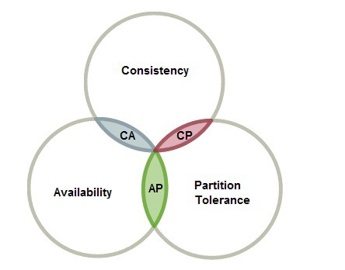
Non functional requirements
In our application we decided to ensure
Consistency: We guarantee to the user to have always updated data in the servers.
Availability: An high availability in order to provide to the user a responce to any query.

Slide 8
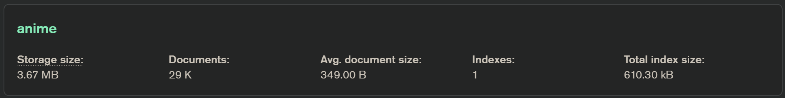
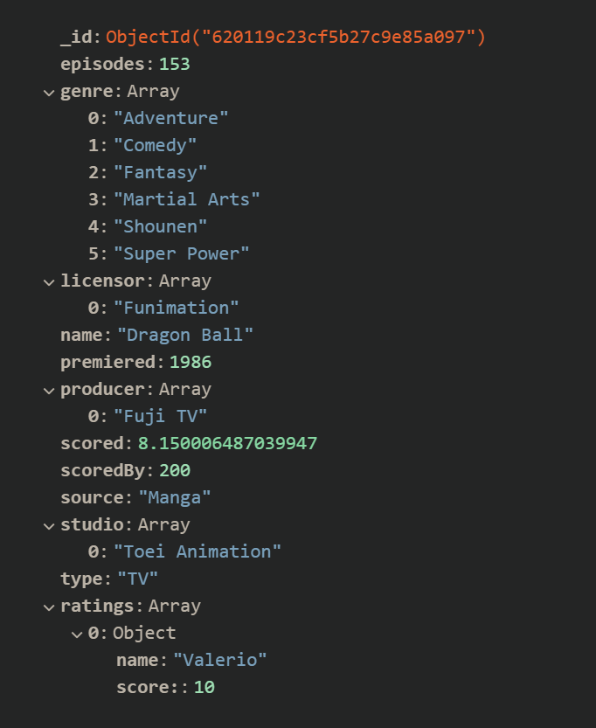
MongoDB
Collection:
Anime
Along with the attributes fields present in the csv file we added an array of embedded documents under the field ratings in order to keep track of the users who voted the anime.

Slide 9
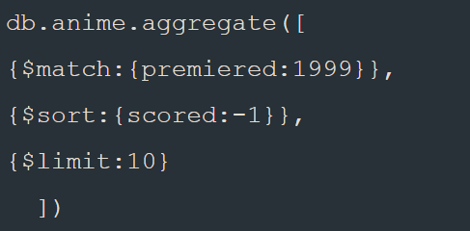
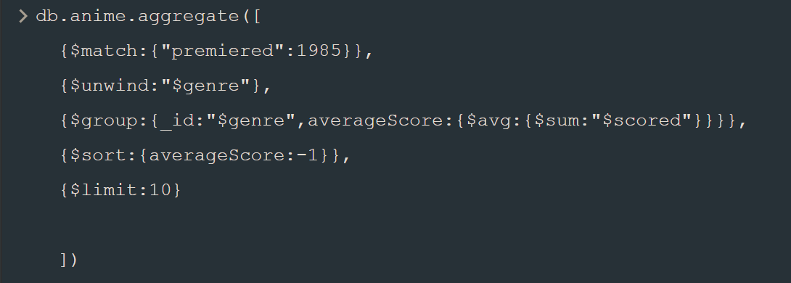
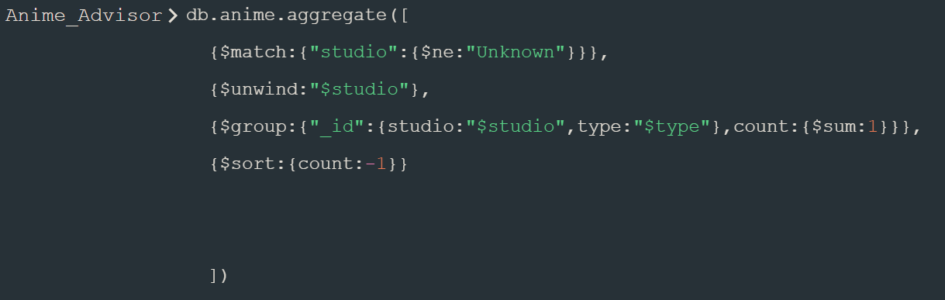
MongoDB Aggregations
Top 10 animes by field (Year,Source,Type,Genre)
Top 10 Studio,Genre or
Producer with the highest
average on a specific year
or oll over the years.
Number of productions of Studios or Producers

Slide 10
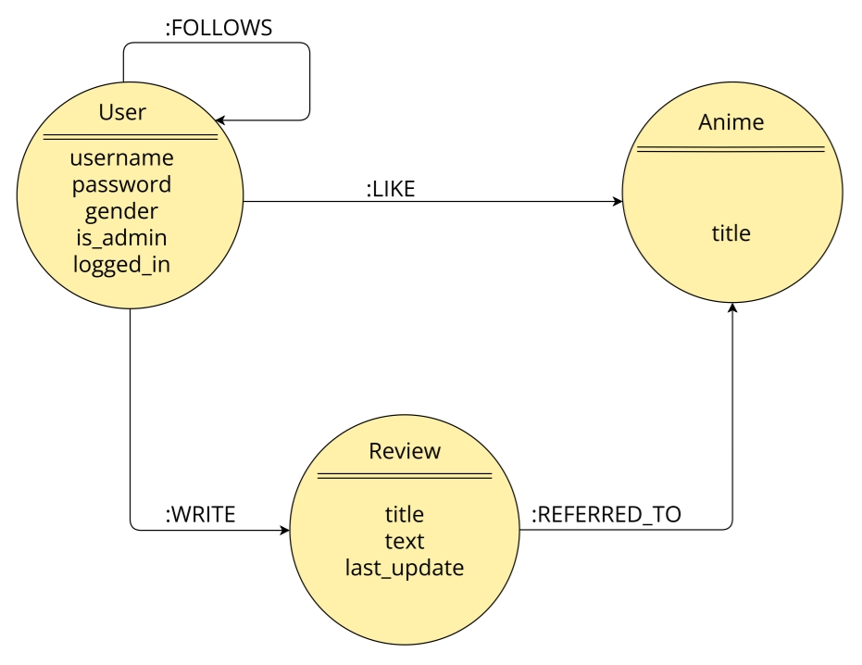
Neo4J
Entities:
User
Review
Anime
Relations:
User->User : Follow
User->Anime : Like
User->Review : Write
Review->Anime : Referred_to
Note:
We decided to store reviews informations only in Neo4J in order to:
Use them for the statistical information section
Limit the interaction between MongoDB and Neo4J in order to avoid possible data inconsistences errors between the two.

Slide 11
Neo4J
High-level queries:
View suggested users
View suggested anime
Show most active users
Show most reviewed animes

Slide 12
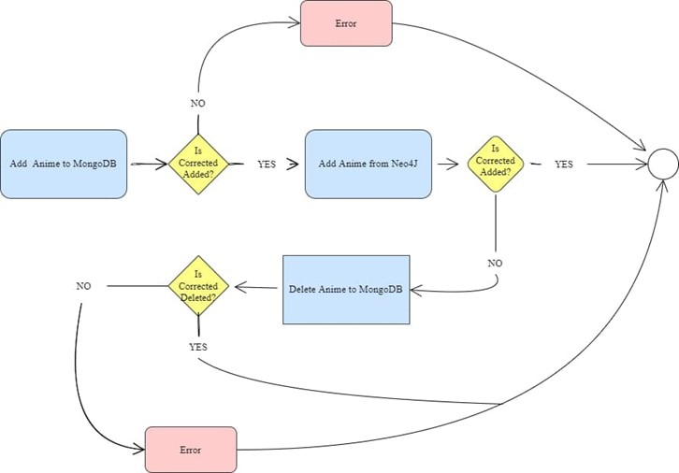
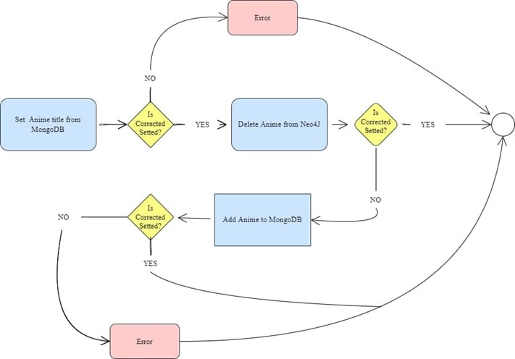

Data consistency between datatabases
In order to preserve consistency of data between the two databases when an anime is:
Added
Deleted
Updated (field name)
A control is being performed on the listed actions in every operation made on the singular databases.
In case of fail an error is returned on screen to the user

Slide 13
Sharding problem
It has been decided to split the dataset into three shards with three replica sets for each shard in order to have both persistency against failures and high availability.
To do this we decided to use a partitional algorithm based on hash strategy.
As possible candidates for the sharding key we took in consideration three attributes of the Anime dataset:
Genre: We first though about using genre as a shard key, but in this case there could have been animes that had many genres in their informations and that could have create redundancy
Year: We though about using the year of premierer of the anime but even in this case there would be probably less researches for old animes and that could have generate an high amount of interactions with the server containing the newest ones and many less interactions with the servers containing the less recent ones.
Name: At the end we decided to use the Name of the animes as shard key. Each shard will contain a range of anime’s initial letters divided into three main chunks. This ensures a good cardinality

Slide 14
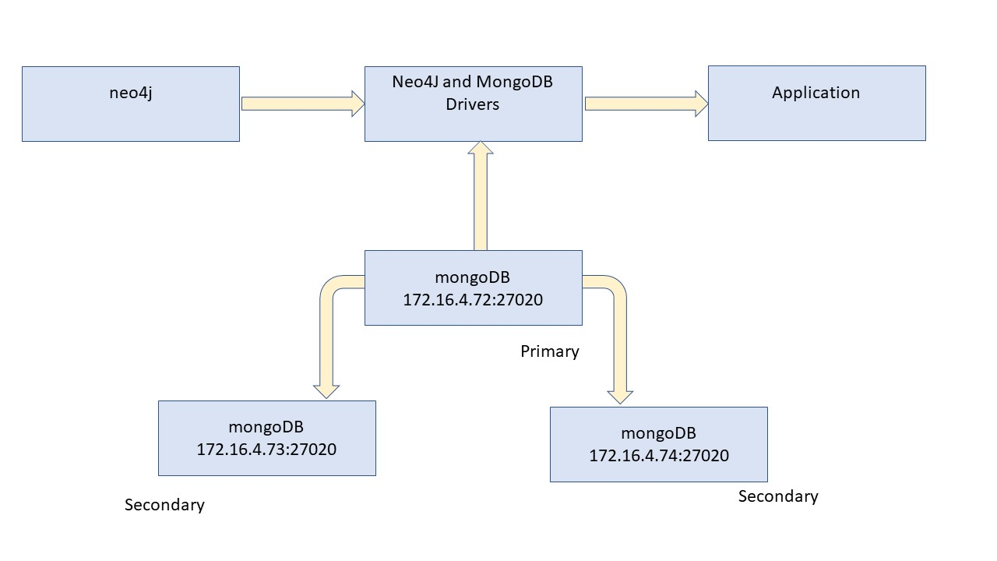
Software and Hardware architecture
Programming language:
Java
DBMSs:
MongoDB
Neo4J
Frameworks:
Maven

